Slide 1
Lecture 4
Dependency Injection using setter method way

Slide 2
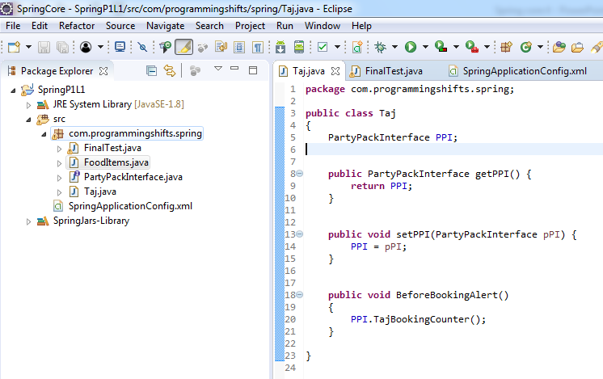

Slide 3


Slide 4


Slide 5


Slide 6
